Slide 1


What makes for a Happy Population:
an Economic, Social, and Citizen Opinions Investigation
Calvin Gao

Slide 2

Tidyverse
Literature Review
1
Past studies
dplyr
ggplot2
qacBase
Data Collection & Merge
2
Merge of two datasets
qacEDA
3
Final Dataset
Split into 3 sets for analysis
Parameter selection
Using PCA to select relevant variables
4
Modeling
5
Linear regression: fixed effects
Cluster Analysis
6
Exploring similar countries
Notes:
This is an overview of what I will be presenting today, I will speak a little of what past research has found, my data sources and data management done to obtain the final dataset
I then used models to select relevant variables which I will then used for a regression model
and finally, I will preview a small portion of the clustering

Slide 3
Past studies
Split the final dataset
Literature Review
Data Collection & Merge
Final Dataset
Parameter selection
Modeling
Tidyverse
Happiness
Subjective well-being
Satisfaction
Utility
Well-being
Welfare
In developed nations, economic progress buys only a small amount of extra happiness.
(Oswald, 1997)
In Japan, improved conditions for groups targeted by reform correlated with increases in well-being.
(Sarracino et al., 2022)
dplyr
ggplot2
qacBase
01
qacEDA
Subjective well-being varies directly with income, inversely with material aspirations. At the start of the life cycle, higher income groups were happier since they were able to purchase more. However, income growth does not cause well-being to increase. With an increase in income, material aspirations increase relatively equivalent to income growth. The two relations cancel one another.
(Easterlin, 2001)
In Europe, happiness is negatively affected by unemployment rate. Spending social resources on unemployment protection and active labour policies have a positive impact on well-being.
(Bonasia et al., 2022)
There is enough evidence that individuals are able and willing to provide meaningful Self-Reported Happiness that leads to many new insights on individual happiness and motivations.
(Ferrer-i-Carbonell, 2013)
02
03
04
05
Merge of two datasets
Classifying similar variables and conducting a regression
Exploring similar countries
Notes:
It is difficult to measure well-being (happiness, subjective well-being, satisfaction, utility, well-being and welfare) GSS
Unemployment should be checked, it is a common theme
Past studies explored mainly economic variables and most studies looked specifically at one country
Happiness is difficult to measure so often, self-reported happiness are often used in place

Slide 4
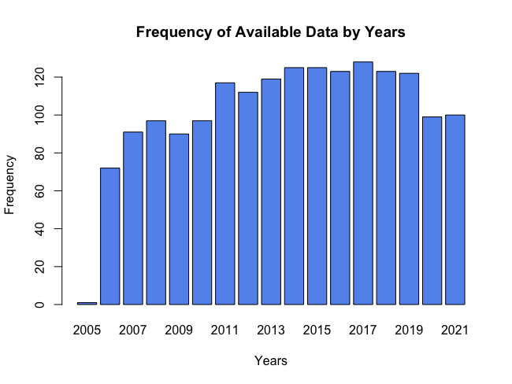
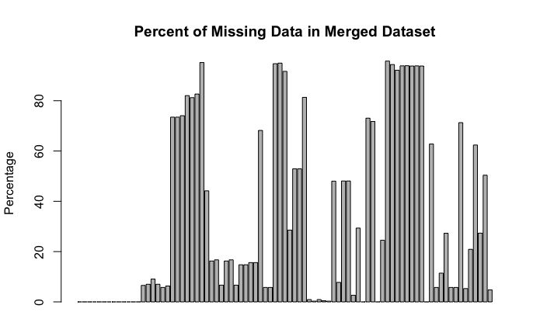
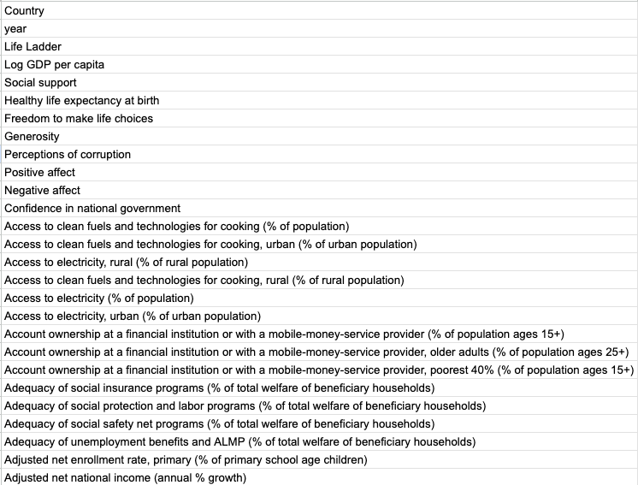
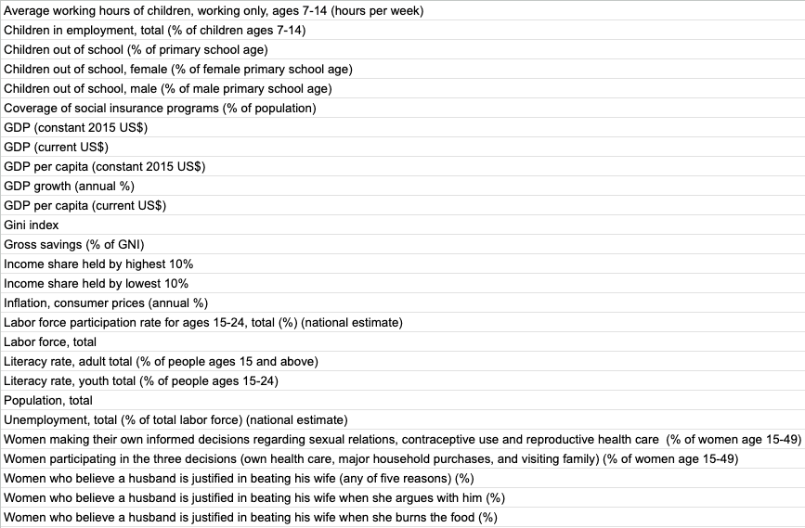
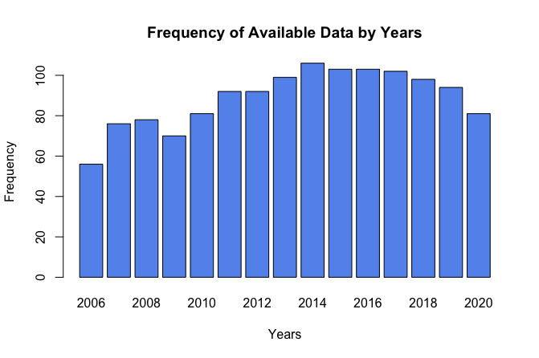
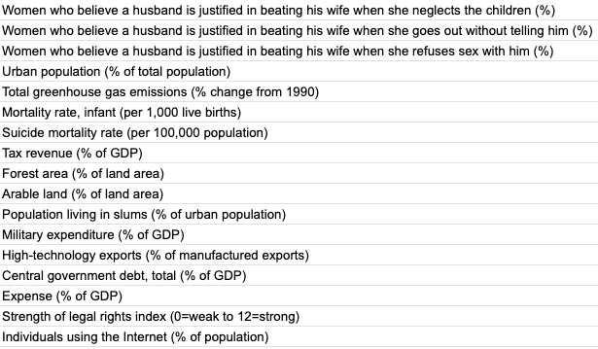

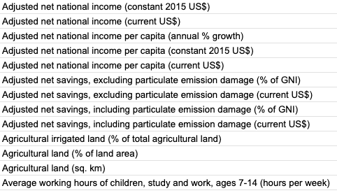

Past studies
Split the final dataset
Literature Review
Data Collection & Merge
Final Dataset
Parameter selection
Modeling
Tidyverse
Missing Data
dplyr
ggplot2
Removed variables with more than 10% missing
Removed remaining missing data
qacBase
Total of 83 Variables
01
qacEDA
02
Final Dataset 2006- 2020
38 Variables
1331 Observations
03
World Bank
2000-2021
72 Variables
World Happiness Report
2005-2021
12 Variables
04
05
Merge of two datasets
Classifying similar variables and conducting a regression
Exploring similar countries
Notes:
I obtained my data from two sources, one being the world happiness report with data ranging from 2005 to 2021 ( and consists of 12 variables.
The second source is from the World bank, which I collected 72 variables from 2000 to 2021. There were quite a lot of interesting variables that I wanted to look into, however, as a problem in many data projects, we have missing data!

Slide 5
Literature Review
Data Collection & Merge
Final Dataset
Parameter selection
Modeling
Missing Data
Removed variables with more than 10% missing
Removed remaining missing data
85 Variables
1741 Observations
1340 Observations
Final Dataset 2006- 2020
38 Variables
1331 Observations
Notes:
On the upper left, I created a frequency bar chart of the number of observations I have for each years. We can see that there is barely any data for the year in 2005. On the right, I have another bar chart that illustrates the percentages of missing data for each variable in the dataset. so higher bars means more missing data. (not great!)
So what did I do? I first took away 2005, then I removed all variables that had more than 10% missing data which left me with 1340 observations.
And did na.omit to get the final dataset with (1331 observations)

Slide 6
Literature Review
Data Collection & Merge
Final Dataset
Parameter selection
Modeling
Missing Data
Removed variables with more than 10% missing
Removed remaining missing data
85 Variables
1741 Observations
1340 Observations
Final Dataset 2006- 2020
38 Variables
1331 Observations
Notes:
On the upper left, I created a frequency bar chart of the number of observations I have for each years. We can see that there is barely any data for the year in 2005. On the right, I have another bar chart that illustrates the percentages of missing data for each variable in the dataset. so higher bars means more missing data. (not great!)
So what did I do? I first took away 2005, then I removed all variables that had more than 10% missing data which left me with 1340 observations.
And did na.omit to get the final dataset with (1331 observations)

Slide 7
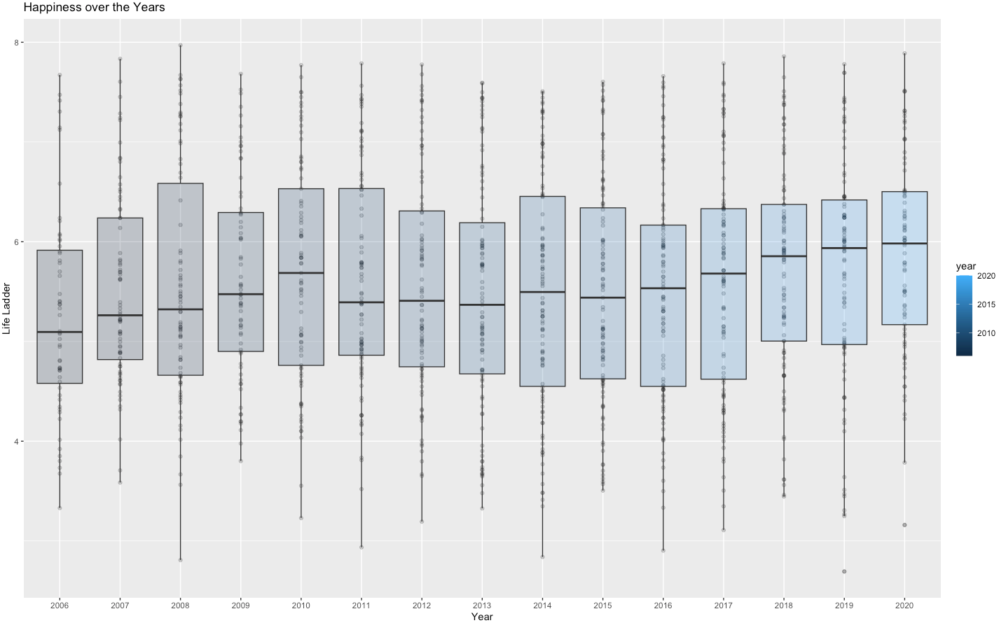
Literature Review
Data Collection & Merge
Final Dataset
Parameter selection
Modeling
Happiness Over the Years
8
Happiness (DV)
Life ladder: Imagine yourself on a ladder, from 0 (worse) - 10, which step are you on now
“Please imagine a ladder, with steps numbered from 0 at the bottom to 10 at the top. The top of the ladder represents the best possible life for you and the bottom of the ladder represents the worst possible life for you. On which step of the ladder would you say you personally feel you stand at this time?”
7
6
Happiness
5
4
3
Year
Zimbabwe
Notes:
Now, let's dive into the happiness variable, which is the focus of this project.
Our happiness variable from the WHR, is collected asking citizens in more than 100 countries to rate themselves on a ladder so ... National average response
Now here is a scatterplot with box plot attached and we see the differences in happiness across the years, now one thing I found surprising was that median happiness still went up slightly during 2007-09 recession and
2019-2020 covid, and also notice that during the covid years, we have a country that had such low happiness scores, this country is Zimbabwe

Slide 8
Literature Review
Data Collection & Merge
Final Dataset
Parameter selection
Modeling
Happiness Over the Years
8
Happiness (DV)
Life ladder: Imagine yourself on a ladder, from 0 (worse) - 10, which step are you on now
“Please imagine a ladder, with steps numbered from 0 at the bottom to 10 at the top. The top of the ladder represents the best possible life for you and the bottom of the ladder represents the worst possible life for you. On which step of the ladder would you say you personally feel you stand at this time?”
7
6
Happiness
5
4
3
Zimbabwe
Social (14 Variables)
Economic (20 Variables)
Year
Country
Region
year
Life Ladder
Access to clean fuels and technologies for cooking (% of population)
Access to clean fuels and technologies for cooking, urban (% of urban population)
Access to electricity, rural (% of rural population)
Access to clean fuels and technologies for cooking, rural (% of rural population)
Access to electricity (% of population)
Access to electricity, urban (% of urban population)
Urban population (% of total population)
Forest area (% of land area)
Arable land (% of land area)
Individuals using the Internet (% of population)
Country
Region
year
Life Ladder
Log GDP per capita
Adjusted net national income (current US$)
Adjusted net national income per capita (current US$)
Agricultural land (% of land area)
Agricultural land (sq. km)
GDP (constant 2015 US$)
GDP (current US$)
GDP per capita (constant 2015 US$)
GDP growth (annual %)
GDP per capita (current US$)
Gross savings (% of GNI)
Inflation, consumer prices (annual %)
Labor force, total
Population, total
Mortality rate, infant (per 1,000 live births)
Military expenditure (% of GDP)
Citizen opinions (12 Variables)
Country
Region
year
Life Ladder
Social support
Healthy life expectancy at birth
Freedom to make life choices
Generosity
Perceptions of corruption
Positive affect
Negative affect
Confidence in national government

Slide 9
Literature Review
Data Collection & Merge
Final Dataset
Parameter selection
Modeling
Economic (20 Variables)
Citizen opinions (12 Variables)
Social (14 Variables)
Country
Region
year
Life Ladder
Log GDP per capita
Adjusted net national income (current US$)
Adjusted net national income per capita (current US$)
Agricultural land (% of land area)
Agricultural land (sq. km)
GDP (constant 2015 US$)
GDP (current US$)
GDP per capita (constant 2015 US$)
GDP growth (annual %)
GDP per capita (current US$)
Gross savings (% of GNI)
Inflation, consumer prices (annual %)
Labor force, total
Population, total
Mortality rate, infant (per 1,000 live births)
Military expenditure (% of GDP)
Country
Region
year
Life Ladder
Access to clean fuels and technologies for cooking (% of population)
Access to clean fuels and technologies for cooking, urban (% of urban population)
Access to electricity, rural (% of rural population)
Access to clean fuels and technologies for cooking, rural (% of rural population)
Access to electricity (% of population)
Access to electricity, urban (% of urban population)
Urban population (% of total population)
Forest area (% of land area)
Arable land (% of land area)
Individuals using the Internet (% of population)
Country
Region
year
Life Ladder
Social support
Healthy life expectancy at birth
Freedom to make life choices
Generosity
Perceptions of corruption
Positive affect
Negative affect
Confidence in national government
Notes:
To begin my analysis, I separated the dataset into three subsets, being economic, subjective or citizens opinions, and social
Go through the variables

Slide 10
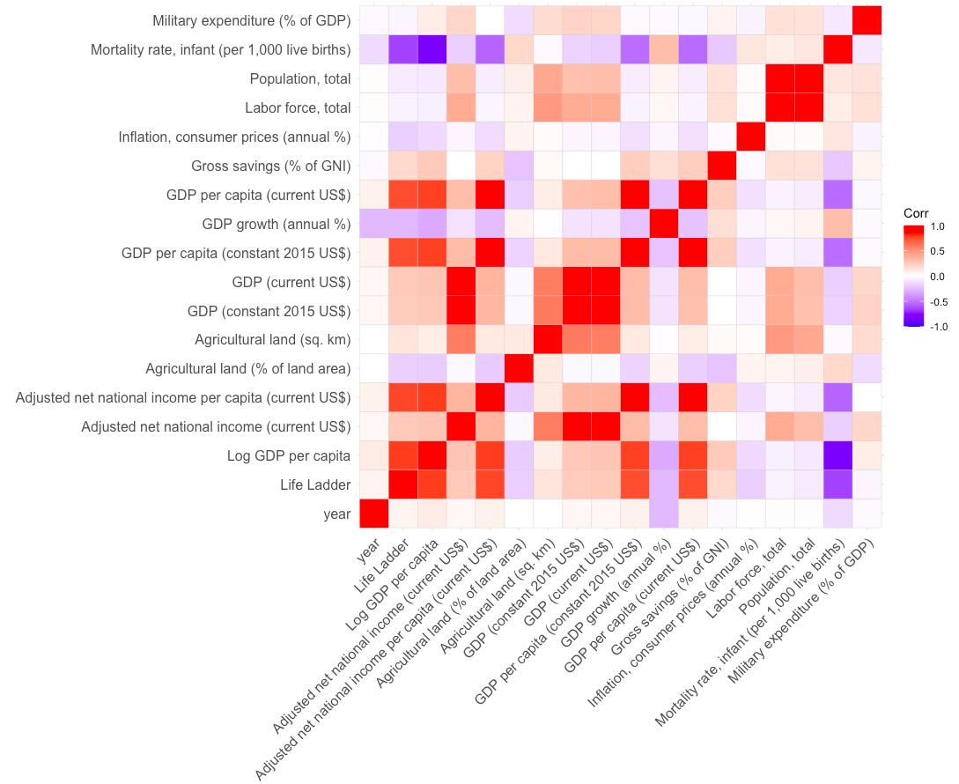
Literature Review
Data Collection & Merge
Final Dataset
Parameter selection
Modeling
Economic (20 Variables)
Country
Region
year
Life Ladder
Log GDP per capita
Adjusted net national income (current US$)
Adjusted net national income per capita (current US$)
Agricultural land (% of land area)
Agricultural land (sq. km)
GDP (constant 2015 US$)
GDP (current US$)
GDP per capita (constant 2015 US$)
GDP growth (annual %)
GDP per capita (current US$)
Gross savings (% of GNI)
Inflation, consumer prices (annual %)
Labor force, total
Population, total
Mortality rate, infant (per 1,000 live births)
Military expenditure (% of GDP)
Notes:
Looking at the corr plotwe find some variables really correlated with one another, so we need to be careful
And it is likely because of variables such as gdp in current US$ or constant year

Slide 11
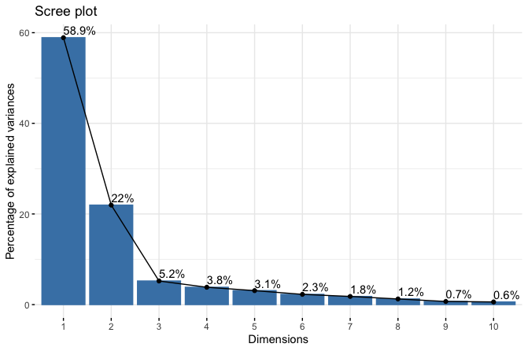
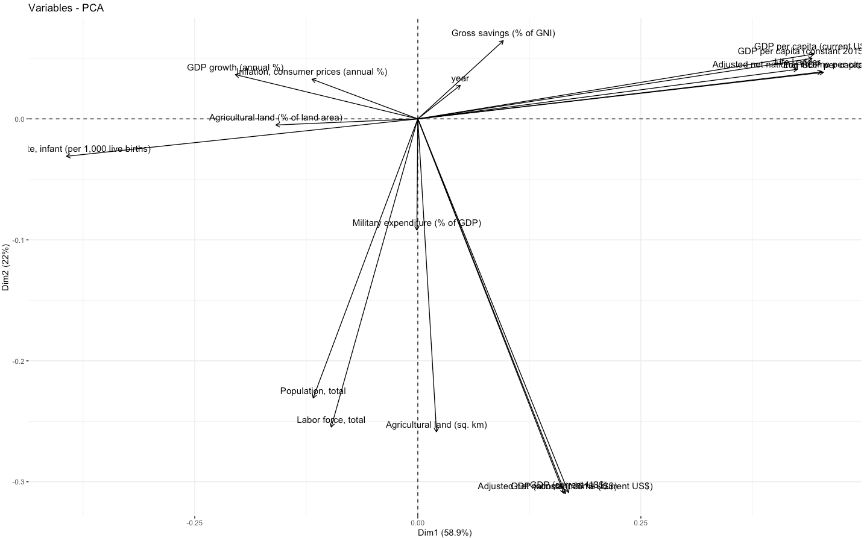
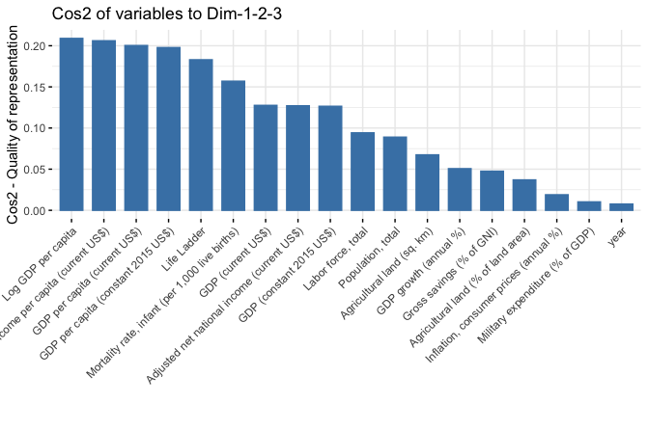
Literature Review
Data Collection & Merge
Final Dataset
Parameter selection
Modeling
Economic (20 Variables)
Notes:
To select the appropriate parameters, I used the PCA model
Started with a scree plot which visualizes the importance of each principal component, About 3 components look good, shows eigen values in a downward curve
The first three PC contain about 86% of the total information in the economic dataset
I then created the biplot to visualize the similarities and differences , show impact of each attribute on principal components, those grouped together are positively correlated to one another, higher the distance from the origin, the better represented the variable is, opposite ends are negative correlation
The third step is to see Cos2 which determines how much each variable is represented in each component, so high values means a good representation
Here I see that GDP variables contribute the most to the first 3 components but we also see that they are too correlated.

Slide 12
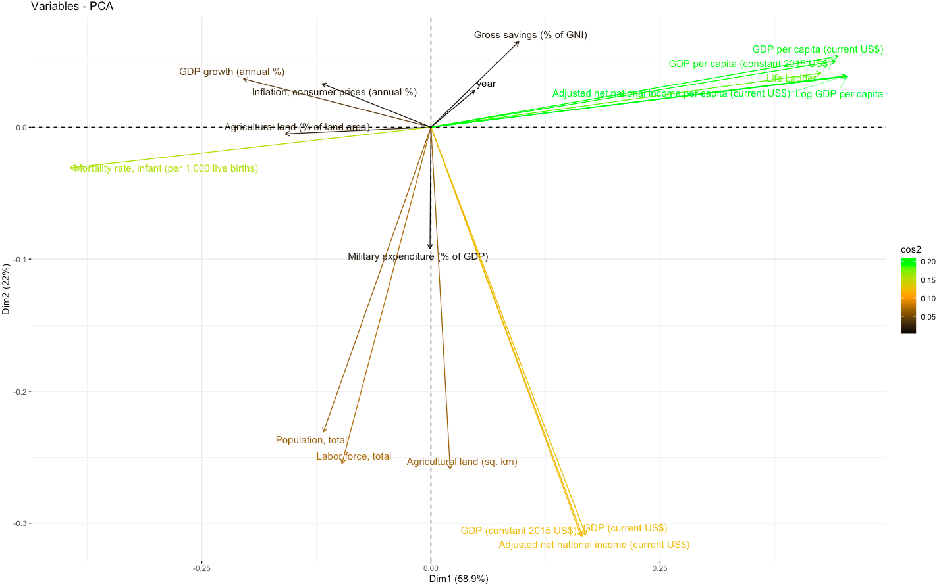
Literature Review
Data Collection & Merge
Final Dataset
Parameter selection
Modeling
Economic (20 Variables)
Gross Savings (% of GNI)
GDP growth (annual %)
Log GDP per Capita
Inflation, consumer prices (annual %)
Mortality rate, infant (per 1,000 live births)
Labor force, total
Agriculture land (sq. km)
Notes:
So,the next step I took was to select one variables from the group that is similar, do in the green bunch here, although they explain a lot, they are all similar. I decided to take log GDP per capita in 2018 dollars among other variables
GDP per capita (constant 2015$)
Gross Savings (% of GNI)
GDP growth (annual %)
Inflation
Agriculture land sq km
Mortality
Labor force total

Slide 13
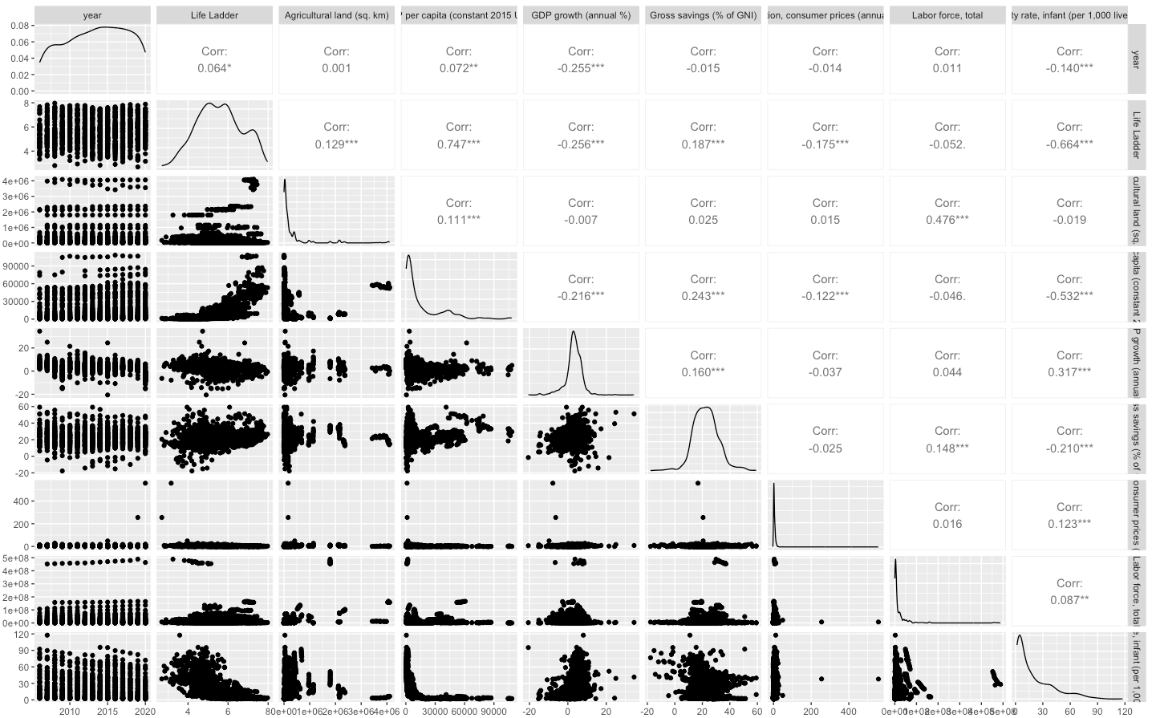
Literature Review
Data Collection & Merge
Final Dataset
Parameter selection
Modeling
Economic (11 Variables)
Notes:
Only labor force not significant correlated with happiness, but we shall see more in the regression model later

Slide 14
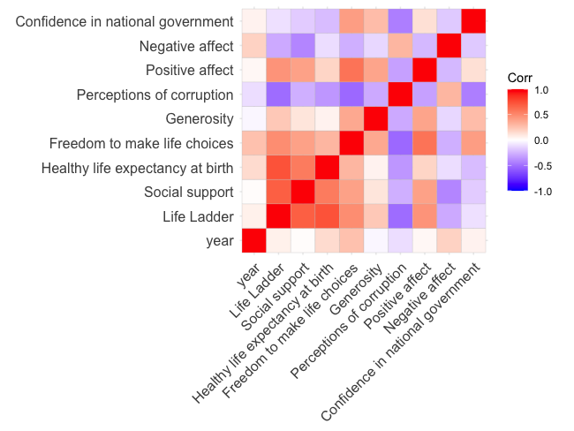
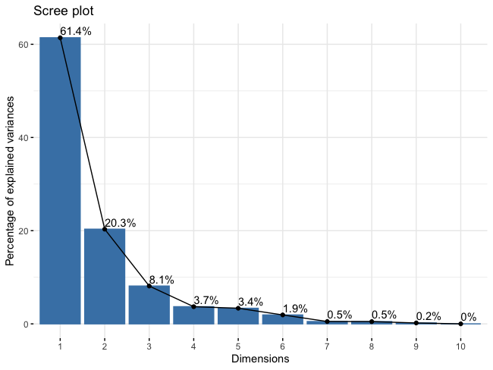
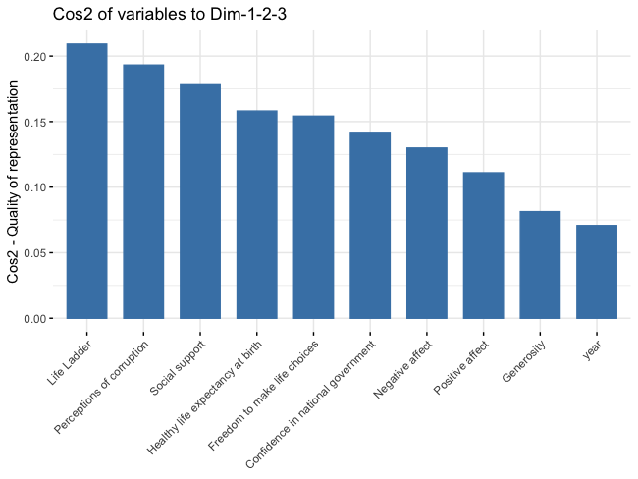
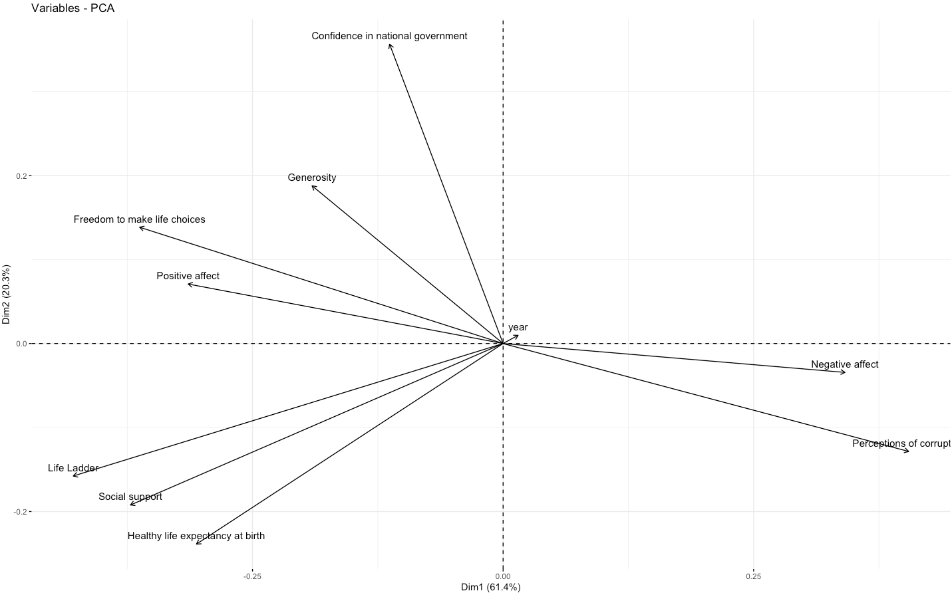
Literature Review
Data Collection & Merge
Final Dataset
Parameter selection
Modeling
Citizen opinions (12 Variables)
Country
Region
year
Life Ladder
Social support
Healthy life expectancy at birth
Freedom to make life choices
Generosity
Perceptions of corruption
Positive affect
Negative affect
Confidence in national government
Notes:
Similar situation here but with the second subset,
Also selected 3 PCs which explains about 90% (89.8)

Slide 15
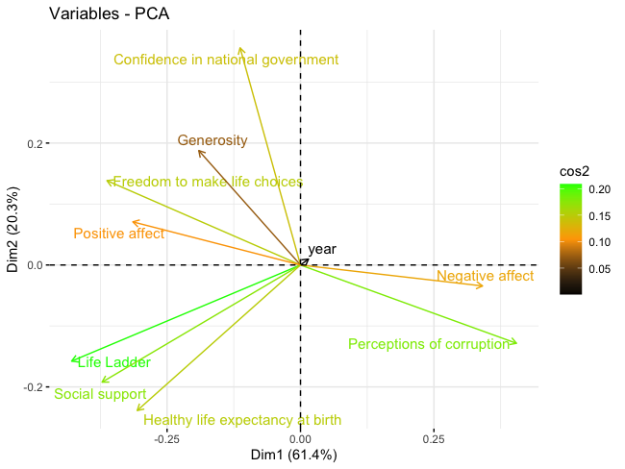
Literature Review
Data Collection & Merge
Final Dataset
Parameter selection
Modeling
Citizen opinions (12 Variables)
Notes:
Keep All

Slide 16
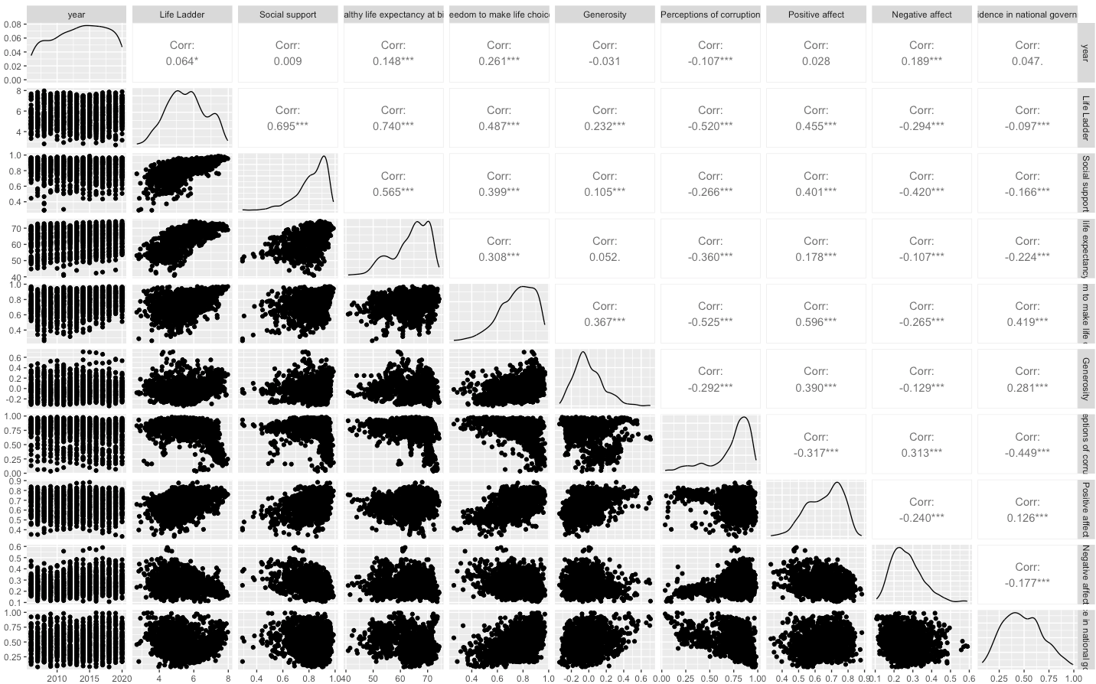
Literature Review
Data Collection & Merge
Final Dataset
Parameter selection
Modeling
Citizen opinions (12 Variables)
Country
Region
year
Life Ladder
Social support
Healthy life expectancy at birth
Freedom to make life choices
Generosity
Perceptions of corruption
Positive affect
Negative affect
Confidence in national government
Notes:
Life ladder correlated with all

Slide 17
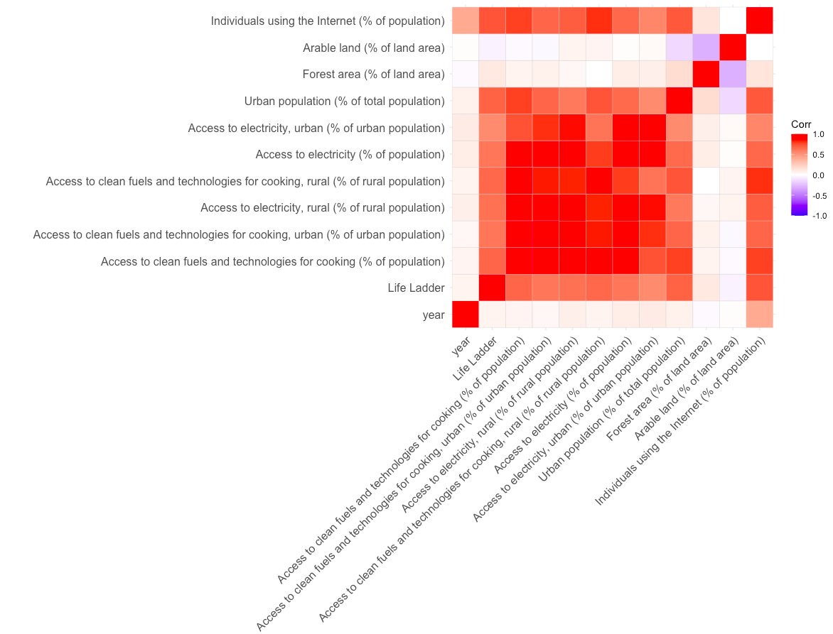
Literature Review
Data Collection & Merge
Final Dataset
Parameter selection
Modeling
Social (14 Variables)
Country
Region
year
Life Ladder
Access to clean fuels and technologies for cooking (% of population)
Access to clean fuels and technologies for cooking, urban (% of urban population)
Access to electricity, rural (% of rural population)
Access to clean fuels and technologies for cooking, rural (% of rural population)
Access to electricity (% of population)
Access to electricity, urban (% of urban population)
Urban population (% of total population)
Forest area (% of land area)
Arable land (% of land area)
Individuals using the Internet (% of population)
Notes:
Very red, variables are correlated, not great

Slide 18
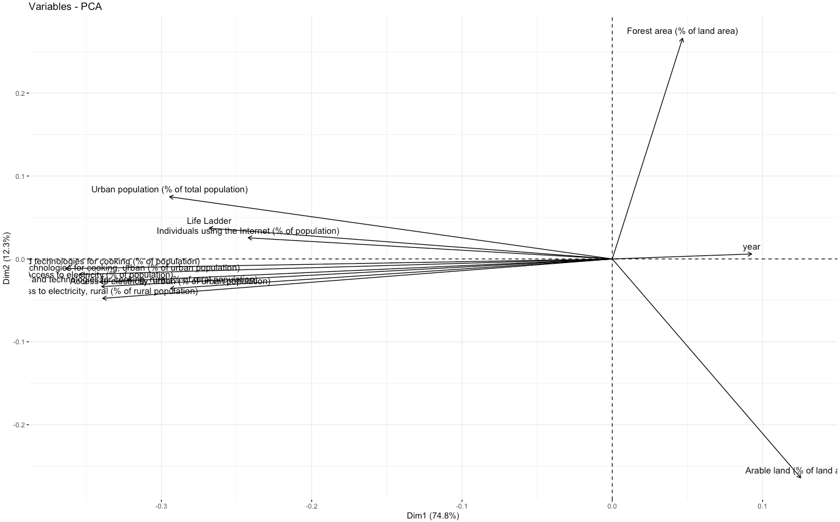
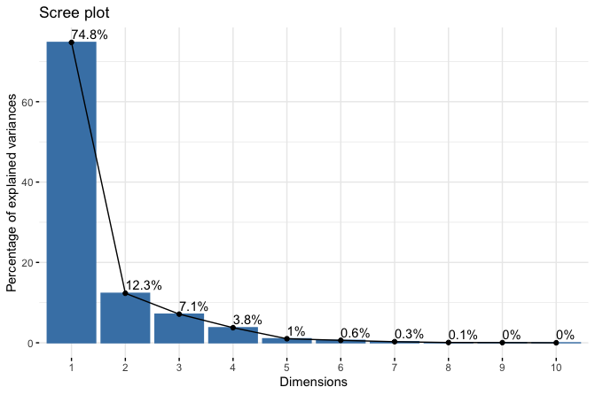
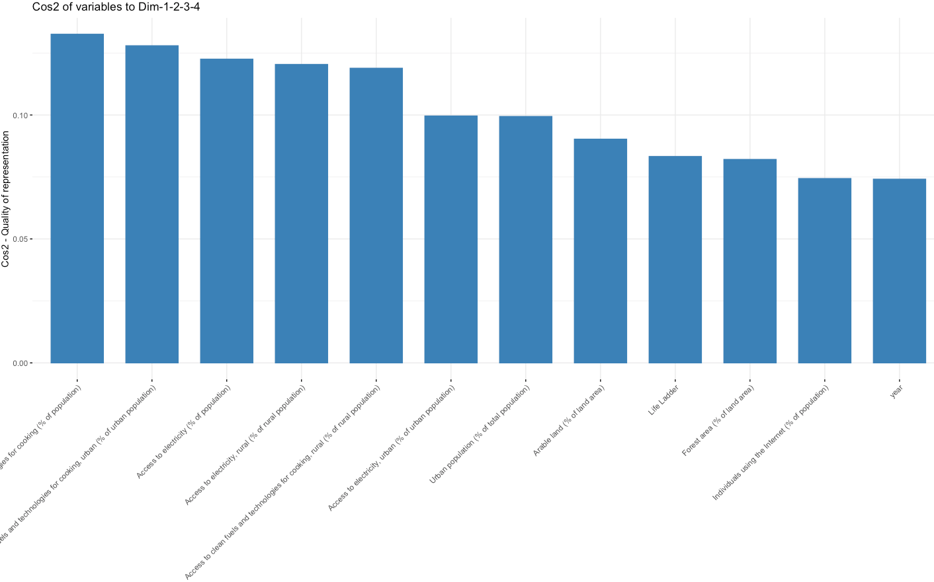
Literature Review
Data Collection & Merge
Final Dataset
Parameter selection
Modeling
Social (14 Variables)
Notes:
4 PCs explain 98%

Slide 19
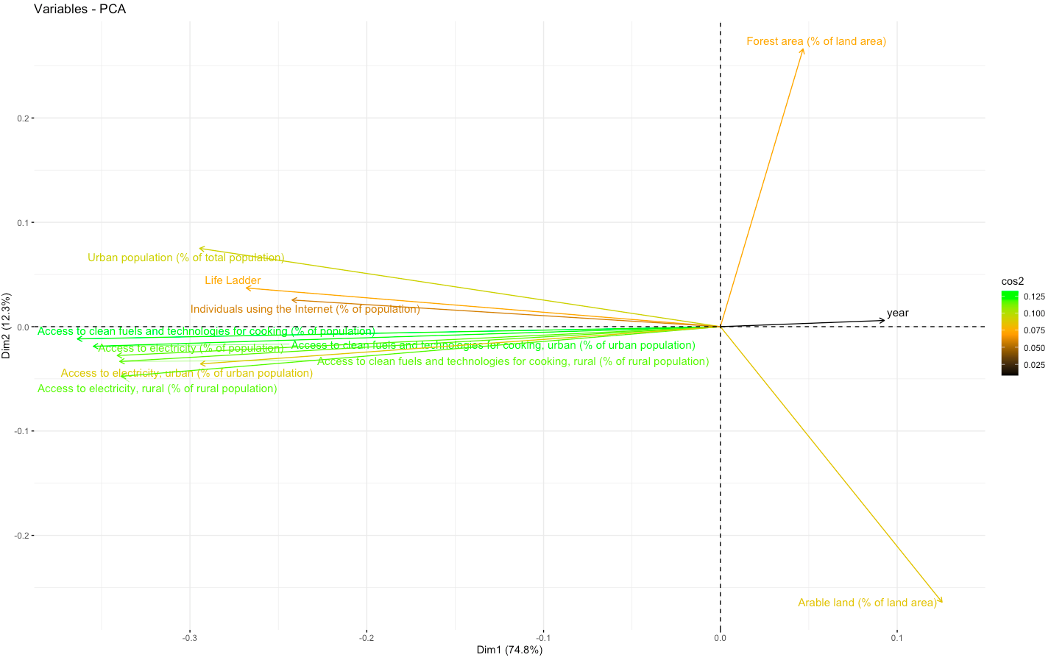
Literature Review
Data Collection & Merge
Final Dataset
Parameter selection
Modeling
Social (14 Variables)
Access to clean fuels
Access to electricity
Notes:
But since they are very correlated I will still have to select one
Cos2, first few variables contribute the most
Access to clean fuels total
Access to electricity total population
Internet
Arable land not significant
Forest area

Slide 20
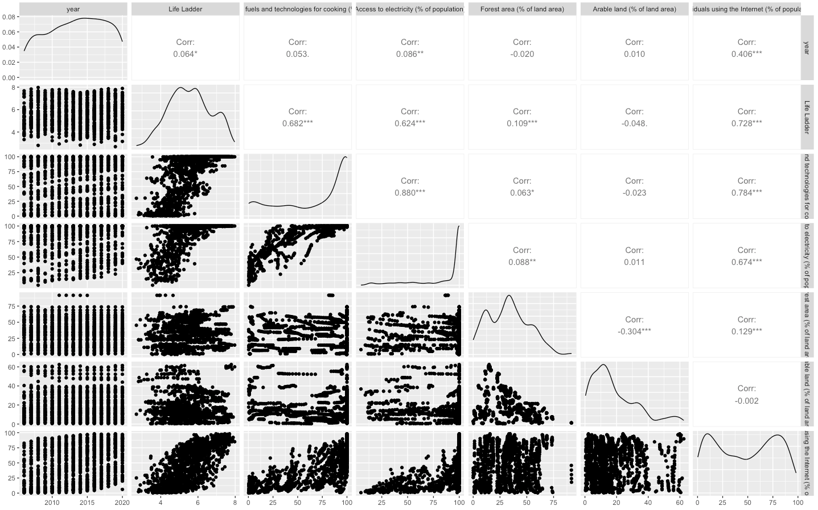
Literature Review
Data Collection & Merge
Final Dataset
Parameter selection
Modeling
Social (9 Variables)
Notes:
Arable land not significant correlated

Slide 21
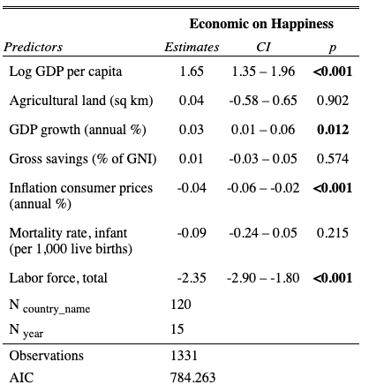
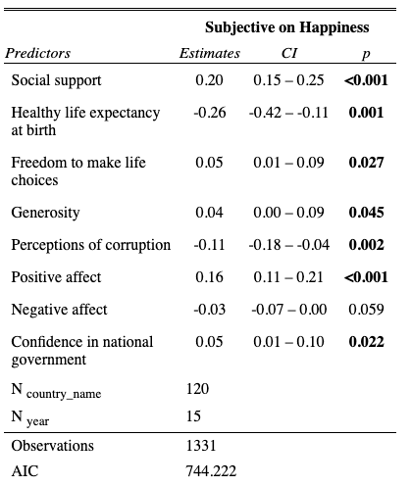
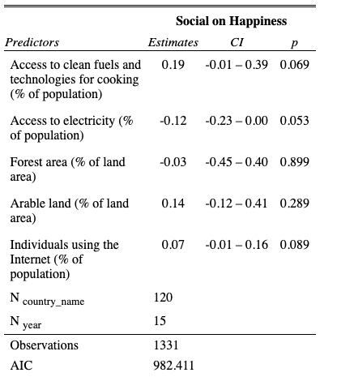
Literature Review
Data Collection & Merge
Final Dataset
Parameter selection
Modeling
Cluster Analysis
Economic (20 Variables)
Citizen opinions (12 Variables)
Social (14 Variables)
Notes:
controlled for fixed effects,
And these variables were adjusted to become a z score, which tells us how much standard deviations away from the mean it is.
Log gdp per capita is signif
GDP growth signif
Infaltion signi
Labor force signif
I do want to mention that gross savings by itself was signif with happiness but it is not indepently associated with happiness when controlling for GDP variables
In citizens opinion, we have more variables
In social, none of them were significant, but the data and variables used definitely limited what we could explore, we did find that the unadjust coeff for internet usage was sig but not when adjusted for other variables

Slide 22
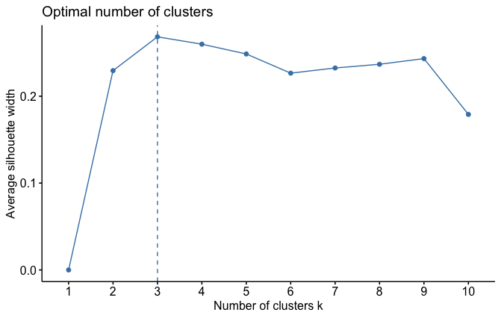
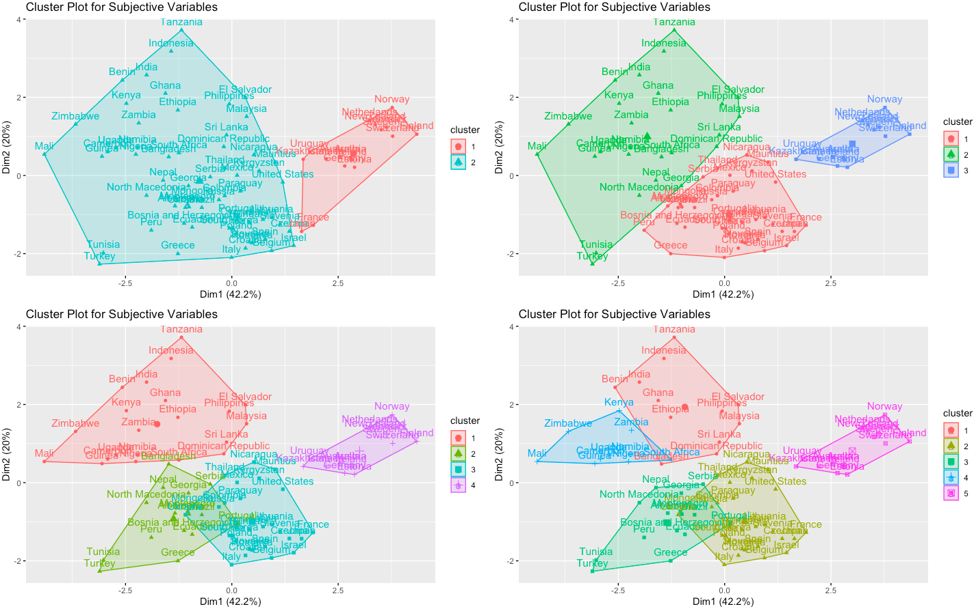
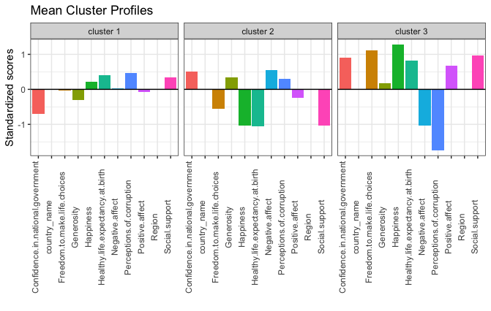
Literature Review
Data Collection & Merge
Final Dataset
Parameter selection
Modeling
Cluster Analysis
Citizen opinions (12 Variables)
Notes:
Around 3 clusters is fine silhouette
This is 2020

Slide 23
Literature Review
Data Collection & Merge
Final Dataset
Parameter selection
Modeling
Cluster Analysis
To be continued

